Slide 1
Autonomic Networking gets serious @IETF 3. KuVS Fachgespräch "Network Softwarization"
https://kn.inf.uni-tuebingen.de/kuvs-fg-netsoft/2022
Toerless Eckert, Futurewei USA (tte@cs.fau.de)
04/7-8/2022
Slides will also be at github.com/toerless/presentations
1

Slide 2
Autonomic Networking in the IETF History
June 2012 draft-behringer-autonomic-network-framework-00.txt
Dec 2013 IRTF Network Management Research Group (NMRG) adopts autonomic networking work
Nov 2014 IETF ANIMA (Autonomic Networking Integrated Model and Approach) working group chartered
Jun 2015 NMRG releases 2 RFC
RFC7575 Autonomic Networking: Definitions and Design Goals
RFC7576 General Gap Analysis for Autonomic Networking
May 2021 Release of ANIMA “Autonomic Networking Infrastructure” (charter round 1: 350++ spec pages)
RFC8366: Validation use case 1: Stable Connectivity (23 pages)
RFC8368: BRSKI voucher (24 pages)
RFC8990: GRASP – Generic Autonomic Signaling Protocol (55 pages)
RFC8991: GRASP API (29 pages)
RFC8992: Validation use case 2: Prefix Management (19 pages)
RFC8993: Autonomic Networking Reference Model (26 pages)
RFC8994: ACP – Autonomic Control Plane (128 pages)
RFC8995: BRSKI – Bootstrap Remote Key Infrastructures (116 pages)
Internet Protocol Journal paper: https://ipj.dreamhosters.com/wp-content/uploads/2021/10/243-ipj.pdf
Since then: Ongoing work in ANIMA (currently 11 working group drafts), NMRG (Intenet) and several others (protocol details)

Slide 3
WHY/HOW ANIMA: Wide range of motivations / goals
Reliable/resilient and secure infrastructure management and services
Remote access. Hacking-safe, “critical infrastructure” support, ...
Intent-based networking
Operations/Automation from higher layer abstracted behavior → ongoing work
Self-X networks
Reliable/resilient and secure mechanisms to build decentralized/distributed network services
X = configuration, automation, optimization, securing, monitoring, ..
ANIMA vs. any other “autonomous, self-X” projects
Other projects top down: “Its all new magic in the SDN layers”. Don’t touch the infrastructure.
ANIMA is bottom up: Not possible to achieve goals without fixing the infrastructure
3

Slide 4
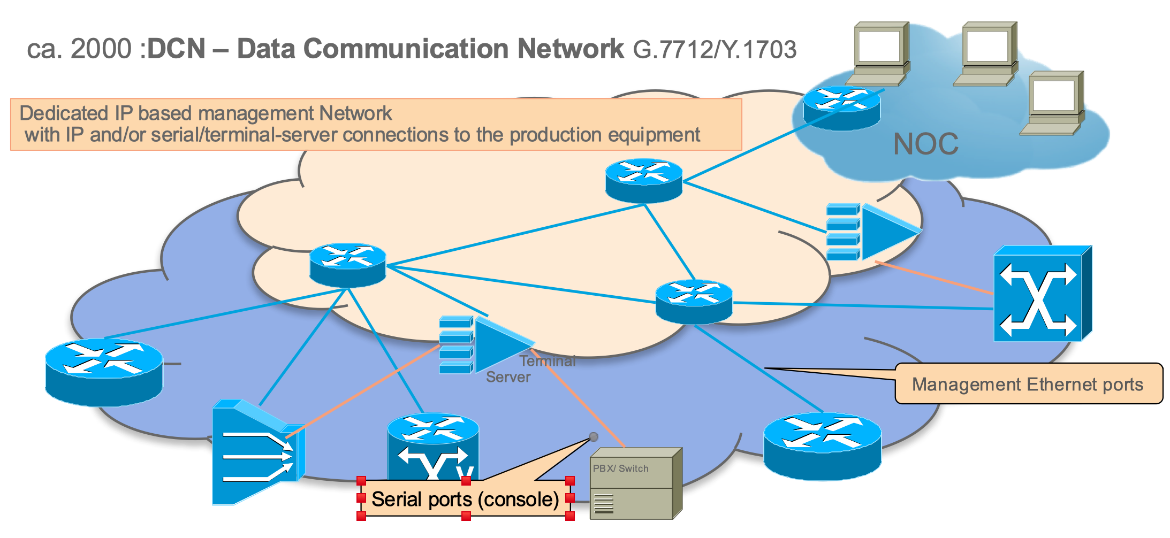
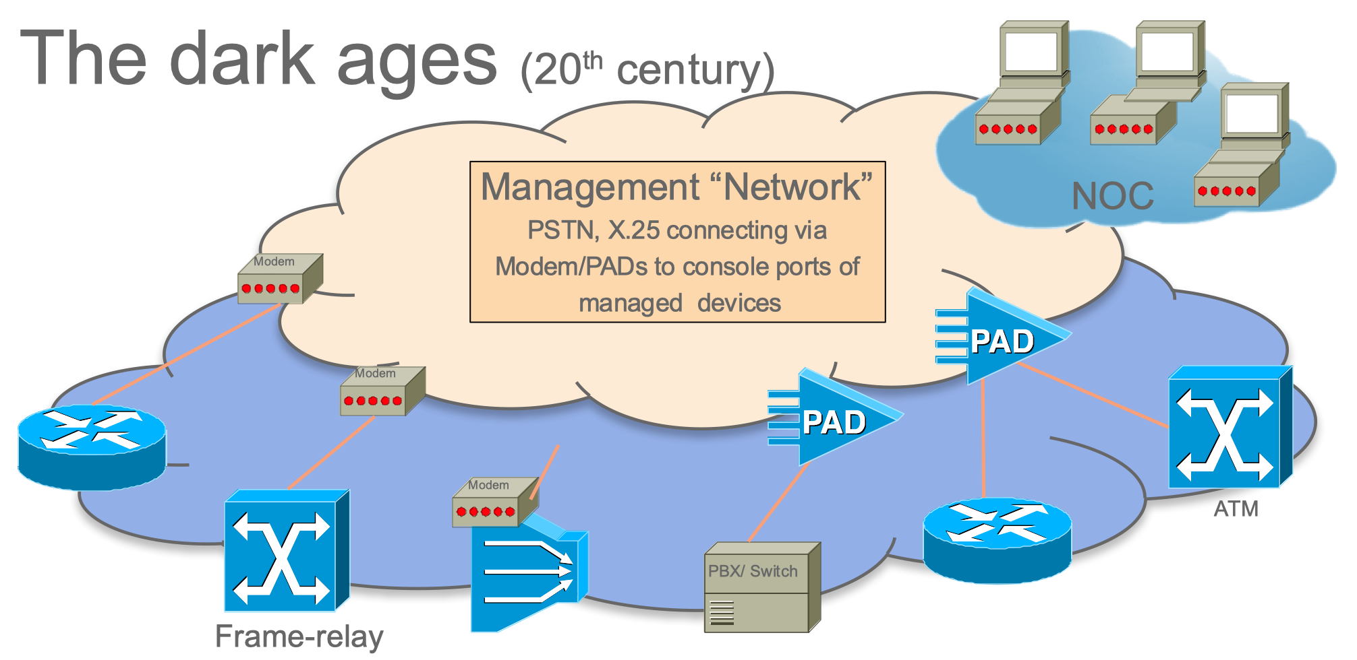
Example goal: Remote Network Management
Images © 2016 Cisco Systems (BRKSDN-2047)
Out-of-band: Separate management networks – EXPENSIVE, COMPLEX

Slide 5
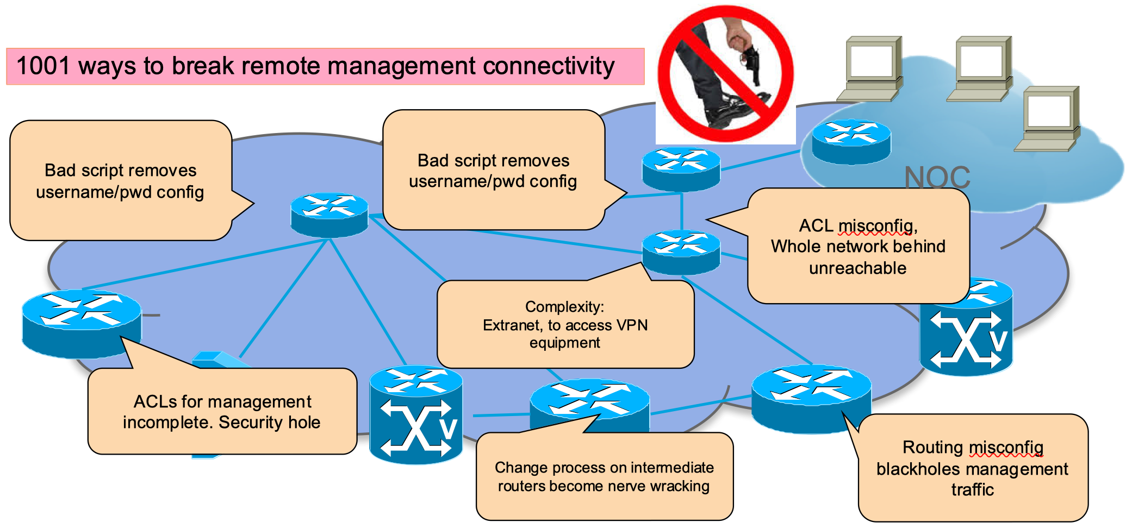
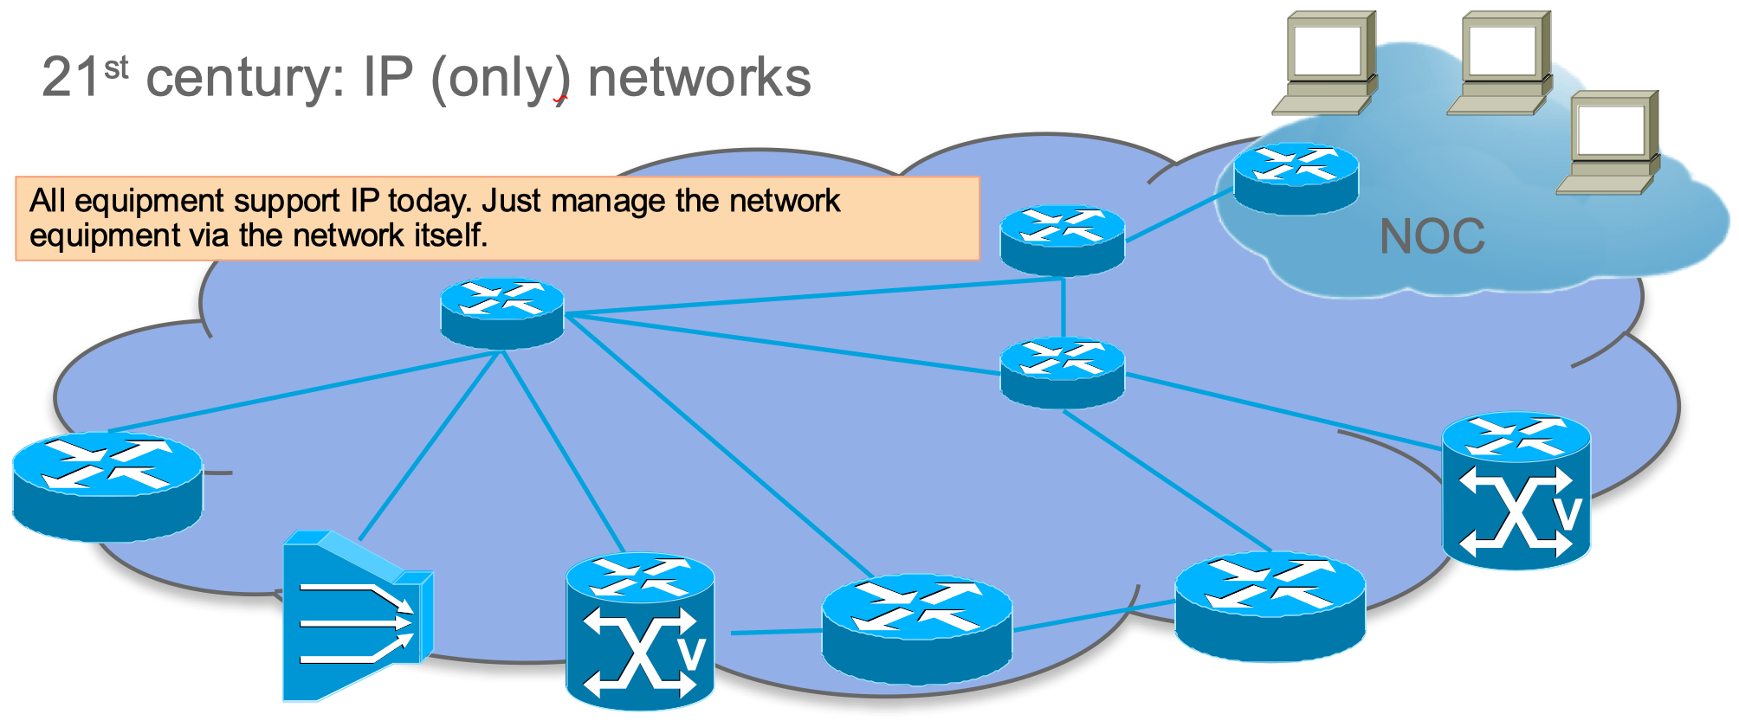
Example goal: Remote Network Management
Images © 2016 Cisco Systems (BRKSDN-2047)
Out-of-band: Separate management networks – EXPENSIVE, COMPLEX
In-band: Use IP network to manage IP network: FRAGILE, ONE-OFFs, COMPLEX
JXXX

Slide 6
In-band Remote Network Management: how bad is it ?
Day-0 issues: Expensive, obfuscated, insecure network bringup
Equipment shipping from/to pre-staging areas, Magically built “initial/bootstrap config”, ...
Day-N issues: Complex , fragile operations
Complex/unknown remote-management connectivity dependencies. ACL (l2, L3, VPN), routing, policies, AAA, protocol securities, PKS chains, clock setting, competing automation systems
Typical recurring incidents: several hours outage in OTT, SP networks
Quantify cost/fragility: Great research topic ?
Except that it is mostly clouded in in-transparency
Sometimes blogs explain some tidbits “we had to send someone to location”, “competing automations killed routing”, ...
Unless there is regulation
USA: When network carries 911 (emergency) phone number service, interruptions are investigated by FCC
Results in public reports: Example from RFC8994 where ANIMA solution would have avoided lengthy outage:
FCC, "June 15, 2020 T-Mobile Network Outage Report", A Report of the Public Safety and Homeland Security Bureau Federal Communications Commission, PS Docket No. 20-183, October 2020, https://docs.fcc.gov/public/attachments/DOC-367699A1.docx
(Tenth of) millions of dollar fines !
No standards: hodgepodge of mechanisms to create “protected” in-band management plane
Mgmt address ranges, VRF, VLANs, VPNs, AAA authorizations (do not touch this config…), ...
6

Slide 7
From NMRG to ANIMA
+------------------------------------------------------------+
| Intent based Network Management |
+------------------------------------------------------------+
| +------------+ |
| | Feedback | |
| | Loops | |
| +------------+ |
| ^ |
| Autonomic User Agent |
| V |
| +-----------+ +------------+ +------------+ |
| | Self- | | Autonomic | | Network | |
| | knowledge |<------>| Service |<------>| Knowledge | |
| | | | Agents | | (Discovery)| |
| +-----------+ +------------+ +------------+ |
| ^ ^ |
| | | |
| V V |
|------------------------------------------------------------|
| Autonomic Network Infrastructure (ANI) |
|------------------------------------------------------------|
| Standard Operating System Functions |
+------------------------------------------------------------+
Figure 1: Reference Model for an Autonomic Node
from RFC7575 slightly enhanced
NMRG Autonomic Networks:
Self-X networks. X = configuring, healing, managing, optimizing, protecting, …. RFC7575/RFC7576
Network wide Intent based management
ASA – Autonomic Service Agents.
Distributed software modules embodying a decentralized or distributed function/service on network devics.
ANI - Autonomic Network Infrastructure
Common infra for ASA and secure automation of legacy networks
BRKI: Secure, zero-touch bootstrap/onboarding
ACP: Secure zero-touch network wide connectivity
GRASP: Secure zero-touch extensible signaling
7

Slide 8

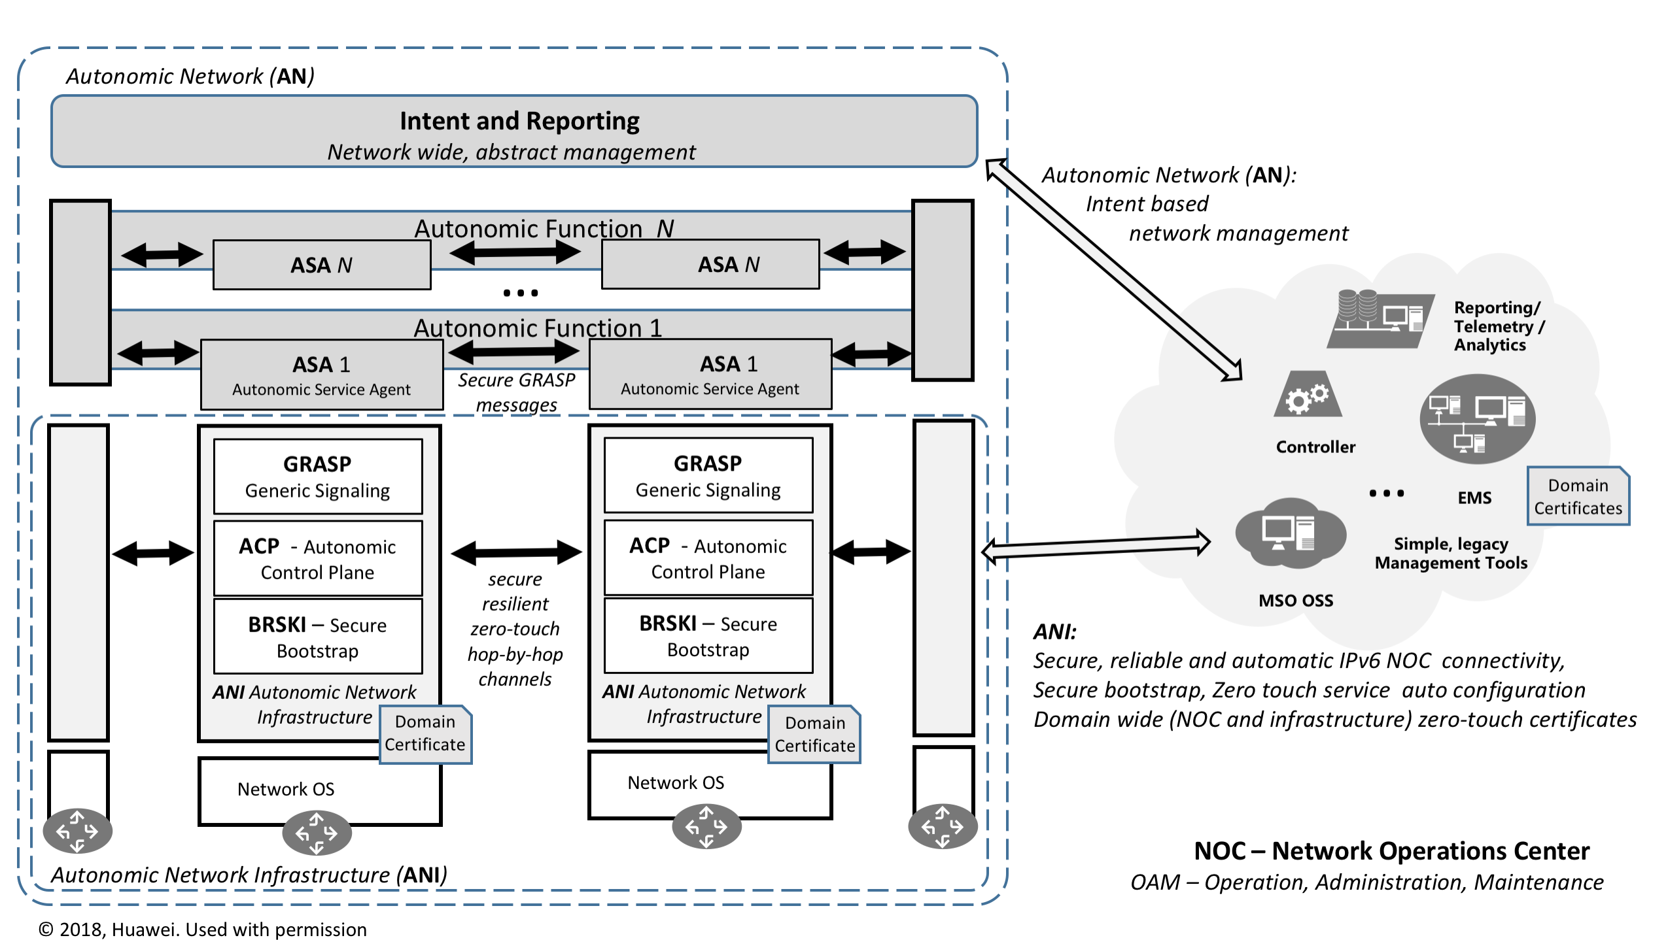
Autonomic Network according to ANIMA RFC8993 (Reference model RFC)

Slide 9
Autonomic Control Plane (ACP) (1)
Router or Switch
Existing router/switch Data-Plane
Management Plane
SSH, Netconf, SNMP, CLI,
Web-Interface,...
Distributed/decentralized
Services such as
Radius, DNS, NTP, syslog, ...
IPv6
Host stack
Control Plane
Routing/Bridging etc.
(multi-VRF) Forwarding Plane
IPv4/IPv6/L2/features/tunnels/...
...

Slide 10
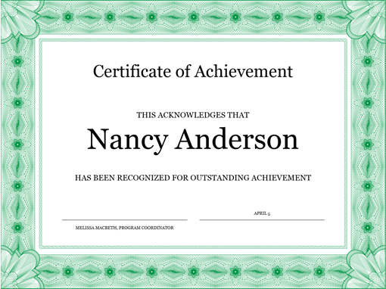
Autonomic Control Plane (ACP) (2) – example/minimum design
ACP capable Router or Switch
ACP Virtual Routing & Forwarding
NO operator/CLI config
Existing router/switch Data-Plane
BRSKI Domain
Certificate
EST / BRSKI
Registrar/Proxy
GRASP/ACP agent
Management Plane
SSH, Netconf, SNMP, CLI,
Web-Interface,...
DULL/GRASP L2
ACP neighbor discovery
RPL routing protocol
Distributed/decentralized
Services such as
Radius, DNS, NTP, syslog, ...
ACP agent VRF/tunnel/ Loopback creation/teardown
Distributed/decentralized
Services such as
Radius, DNS, NTP, syslog, ...
IPv6 packet forwarding
ACP
IPv6
ULA
Loopback
Address/
Interface
IPv6
Host stack
Control Plane
Routing/Bridging etc.
IPsec/DTLS
IPv6 tunnel
IPsec/DTLS
IPv6 tunnel
(multi-VRF) Forwarding Plane
IPv4/IPv6/L2/features/tunnels/...
...
provide/use ACP connectivity
provide/use certificate for security
physical router interfaces

Slide 11
Autonomic Control Plane (ACP)
PRE
X.500 certificate for the ACP <DOMAIN>
Includes IPv6 ACP loopback address field
Any PKI Mechanism: manual … BRSKI
ACP
0. Simple, scalable routing protocol (RPL) runs in ACP
All routes are /128 ACP loopback address routes
1. ACP neighbor auto-discovered on subnets DULL-GRASP
2. Single-hop secure-channel built to ACP neighbor
Requiring peers with X.500 DOMAIN certificate
Negotiated; IPsec, DTLS or other
Uses only link-local IPv6 addresses
3. Secure channels become P2P interfaces in the ACP VRF
Uses only link-local IPv6 addresses
4. GRASP/ACP provides network-wide signaling
Reliable hop-by-hop multicast for service discovery
ACP VRF
NO operator/CLI config
GRASP/ACP agent
DULL/GRASP L2
ACP neighbor discovery
RPL routing protocol
ACP agent VRF/tunnel/ Loopback creation/teardown
IPv6 packet forwarding
For Host stack apps accessing ACP
ACP
IPv6
ULA
Loopback
Address/
Interface
IPsec/DTLS
IPv6 tunnel
IPsec/DTLS
IPv6 tunnel
Domain
Certificate
BRSKI Domain
Certificate
ACP secure virtual connections
With GRASP signaling

Slide 12







Autonomic Control Plane (ACP)
“NOC”
Controller
Orchestrator
…
Mgmt
Laptop
Domain
Certificate
RESULT
Infrastructure Reliability
No SDN/manual config. CANNOT be broken by SDN/CLI.
(Minimal) no physical misconfiguration possible
“You plugged the cable into wrong port” – will not disrupt ACP
Infrastructure Security
Unwanted devices can not get into ACP (no DOMAIN cert)
No eavesdropping/MitM-attacks against ACP
OPERATIONS
Router in a Network Operations Center (NOC) can have unencrypted ACP interfaces
To connect legacy management/SDN systems without ACP
ACP has automated DOMAIN certificate renewal
Across ACP (“unbreakable”)
Zero-touch – CA in/behind NOC
ACP IS NOT CONNECTIVITY FOR USERS/HOSTS!
Operator/SDN still needs to configure “Data-Plane”
Domain
Certificate
Domain
Certificate
Domain
Certificate
Domain
Certificate
Domain
Certificate
Domain
Certificate
Domain
Certificate
Domain
Certificate
Domain
Certificate
Domain
Certificate
Autonomous or legacy network with ANI
ACP secure virtual connections
With GRASP signaling
BRSKI Domain
Certificate

Slide 13







Classic Broken remote automated PKI enrollment
PKI Registrar
Drives/coordinates process
E.g: EST RFC7030 enrollment protocol
Admission Control
How to give connectivity to Pledge ?
Pledge connected in remote location
Pledges are router/switches
Today all IP/routing manually configured
Enrollment of hosts easier
When they can assume a working/secure network infra
How to protect against attacks ?
How does Pledge trust Registrar instead of attacker ???
Today: They don’t!
Remote cert enrollment easily attackable
Today: Secure/local pre-staging location
Network
Backend
Pledge
Candidate network Device
Optional
Get permission
to admit
pledge
Certificate
fe8…@lake
Domain
Admission
Controller
?
what IP
connectivity
Certificate
fe8…@lake
Attacker
Fakes pledge
Man in Middle
Misconfigures Pledge
Gets into network
Make CA
sign pledge
certificate
CA
Certificate
Authority
for the ANI domain
PKI Registration Authority

Slide 14


Bootstrap to ANI (ACP+BRSKI) DOMAIN membership PKI enrollment with ACP/Voucher/MASA
ANI
Backend
Pledge
Candidate ANI Device
Voucher – new crypto artefact
New digital artefact to indicate to Pledge that Registrar is authorized to control Pledge
Manufacturer (MASA) – new cast member
Run on behalf of manufacturer of Pledge
Pledge can trust MASA because Pledge software can have its manufacturers Trust anchors
MASA generates voucher for Registrar
After it has validated DOMAIN owns Pledge
Proxy – new cast member
Distributed Agent to give registrar connectivity to adjacent pledge
Relies on ACP to talk to Registrar
ACP Address allocation – new feature
Optional
Get permission
to admit
pledge
Certificate
fe8…@lake
Link-Local
Domain
Admission
Controller
Voucher
BRSKI/ACP
Proxy
Voucher
Certificate
fe8…@lake
Certificate
fe8…@lake
Make CA
sign pledge
certificate
CA
Certificate
Authority
for the ANI domain
Get Pledge identity
Enroll Certificate
With ACP info
(address)
Voucher
“My duckling,
trust that registrar”
MASA
Manufacturer
Authority
manufactured
the pledge
Domain Registrar
Allocate ACP Address
Address allocation database
Chick6: fd89b714f3db0000200000064000006
For secure/ANI
Pledges:
Get voucher
DO NOT
ERASE

Slide 15

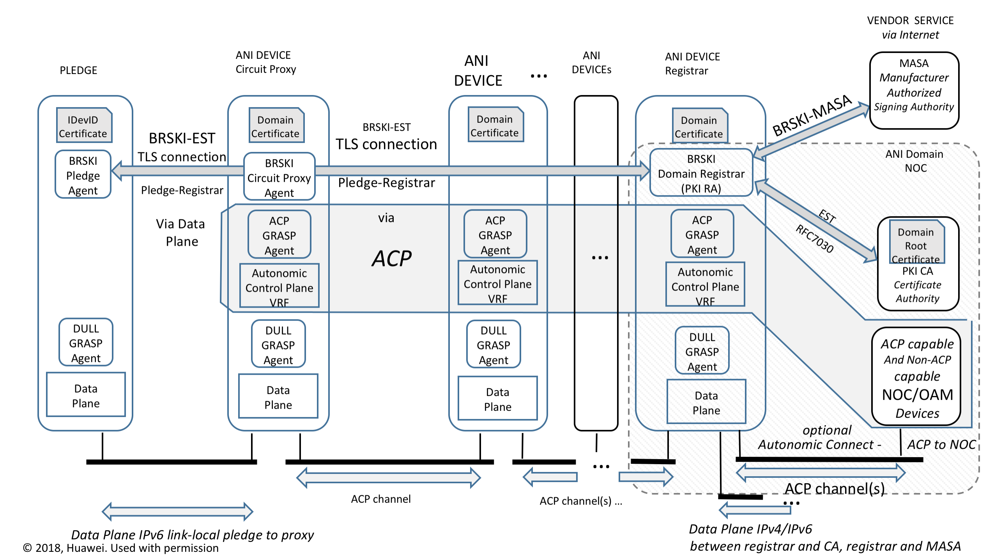
For self-study: How does it really work – ANI (1)

Slide 16
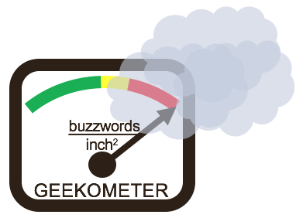
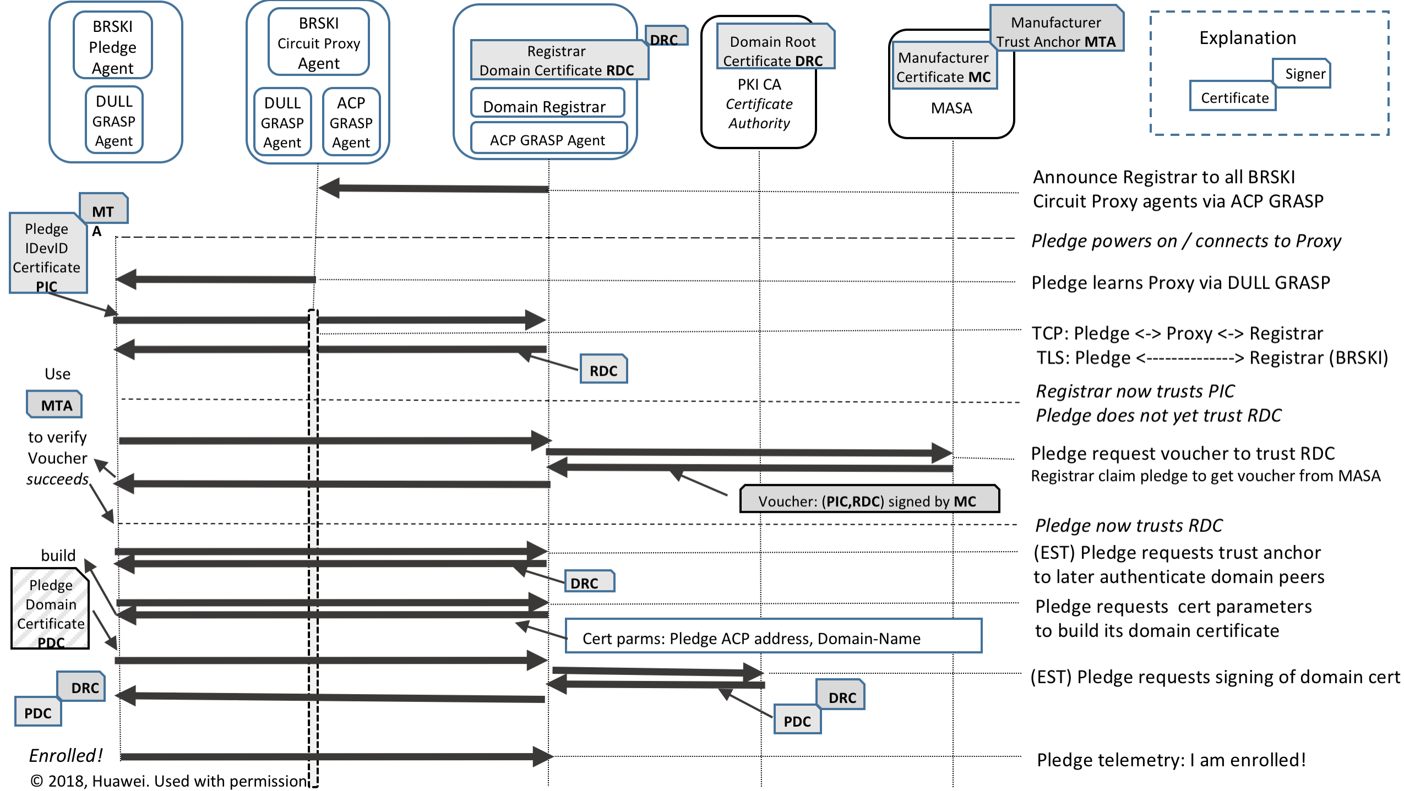
For self-study: How does it really work - BRSKI (2)

Slide 17

Example Minimum ANI Setup/Config
Manufacturer 1
MASA
Manufacturer N
MASA
…
ani registrar
domain-name ani.example.com
Ethernet 0
acp-connect
Register my cert with vendor MASAs
Internet
“NOC”
Mgmt
Laptop
Seed Router
ANI BRSKI/PKI Registrar
and CA (example)
Ethernet 0
Domain
Certificate
Domain
Certificate
Domain
Certificate
Domain
Certificate
Domain
Certificate
Domain
Certificate
Domain
Certificate
Domain
Certificate
Domain
Certificate
Domain
Certificate
Domain
Certificate
Domain
Certificate

Slide 18
Where are we now on the Autonomic Network vision ?
Since Q2’ 2020 on 2nd Charter
Added ASA work to charter
Added ANI enhancement
Pushed out Intent back to NMRG
NMRG nicely working on the research steps
ANI: Bootstrap sees quite wide proliferation/adoption across IETF and industry (next slide)
Hackathons, Also iot-onboarding / MUD adjacencies
Relatively little new code (on top of exising PKI, tool chains), but quite security critical, open source available
Many different protocol preferences in different markets = many variations needed/worked on in IETF.
ANI: ACP seeing little movement yet
Logical ? Bootstrap must first work
Pre-standard industry implementations exist. Legacy router implementation complex.
Open Source (linux, openwrt, rare?, ...) implementations missing
Open Source components exist (BRSKI, GRASP, IPsec(*Swan)).
Linux Name spaces should make it easy to build the ACP setup/teardown

Slide 19
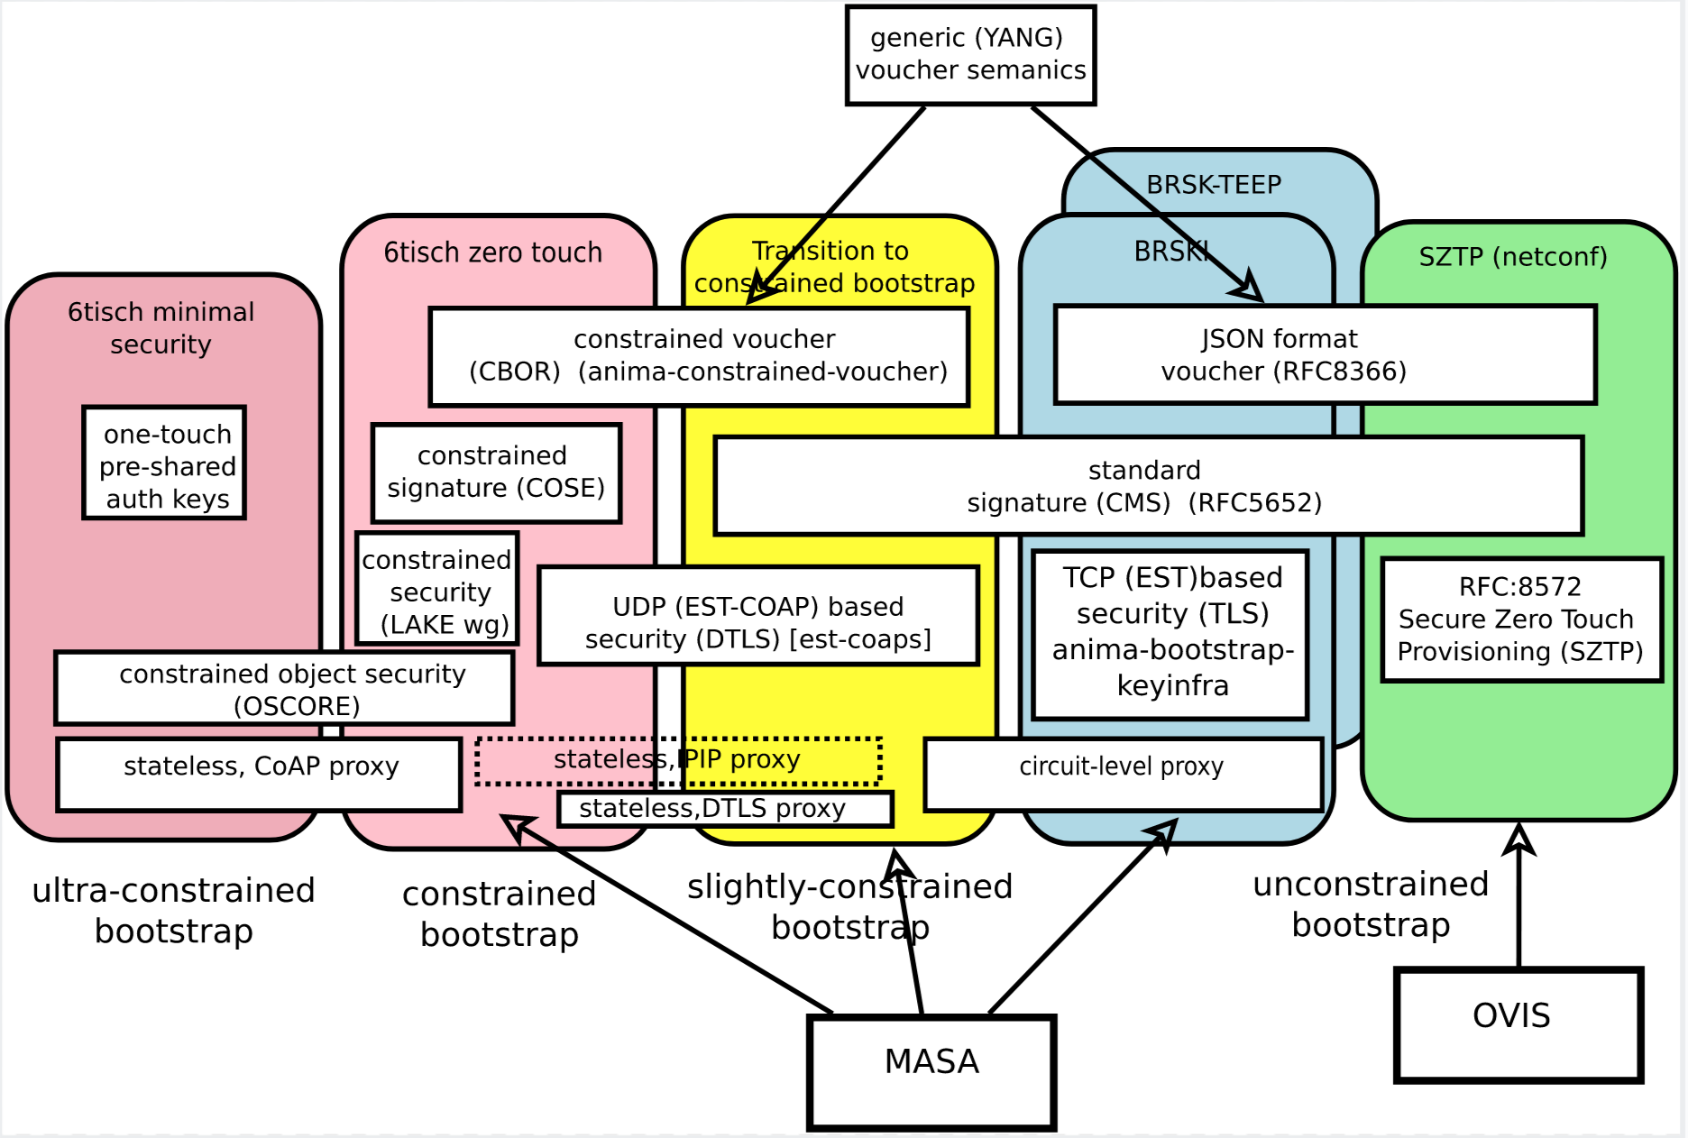
For self-study: Bootstrap landscape / roadmap https://github.com/anima-wg/enrollment-roadmap (somewhat stale)
19

Slide 20
Distributed Automation: ASA
Ongoing work in NMRG, then maybe ANIMA ?
+------------------------------------------------------------+
| Intent based Network Management |
+------------------------------------------------------------+
| +------------+ |
| | Feedback | |
| | Loops | |
| +------------+ |
| ^ |
| Autonomic User Agent |
| V |
| +-----------+ +------------+ +------------+ |
| | Self- | | Autonomic | | Network | |
| | knowledge |<------>| Service |<------>| Knowledge | |
| | | | Agents | | (Discovery)| |
| +-----------+ +------------+ +------------+ |
| ^ ^ |
| | | |
| V V |
|------------------------------------------------------------|
| Autonomic Network Infrastructure (ANI) |
|------------------------------------------------------------|
| Standard Operating System Functions |
+------------------------------------------------------------+
Figure 1: Reference Model for an Autonomic Node
from RFC7575 slightly enhanced
!?
ACP provides network-wide any-to-any
automatic reliable, secure connectivity,
GRASP/ACP provides any-to-any
ASA discovery and communication primitives
Several comprehensive,
ambitious architecture proposals in ANIMA over the years. Some simple WG drafts now.
Many options easy to implement, easy experimentation
ANI and extensions: ongoing in ANIMA
and especially bootstrap also in other groups
20

Slide 21
Security: Many simple/incremental ANI use-cases
ANI Certificates for protocols/solutions with End-to-end security (e.g.: TLS, QUIC)
ANI: Strong, automatically renewed and flexible PKI certificates
Alternative to username/password and Web PKI
ANI resolves manual certificate management issues
ANI + simple script based ASA to secure many infrastructure services using Data-Plane
Many protocols with their own “security” mechanism (but no key management)
“auto-secure”: NTP, SMTP, MacSec, routing protocols (BGP, IGP, PIM), IPFIX and others
Also “auto-secure” TLS/QUIC solutions that can not use client-certificates (but only Web-PKI)
ACP makes legacy protocols (without security) more secure when they run across ACP !
Hop-by-hop authentication/encryption
21

Slide 22
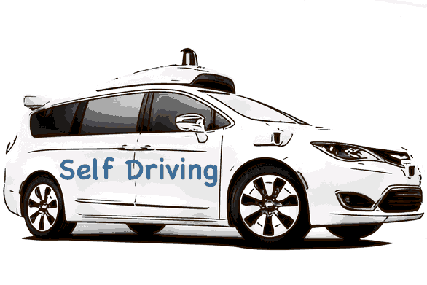
Self-driving: what if networks where cars
SDN-Controller
SDN-Orchestrator
SDN-Developer
Data Analyst
Network operator
Security Expert
In-network intelligence
ANIMA
networks
“self driving network” ?

Slide 23
The End
Please engage with us (proposal, questions, suggestion)
if you think this is useful for you !
anima@ietf.org

